Slide 1
Wind Energy Conversion Systems
Muhammad Shamaas
2018-MS-EE-4

Slide 2
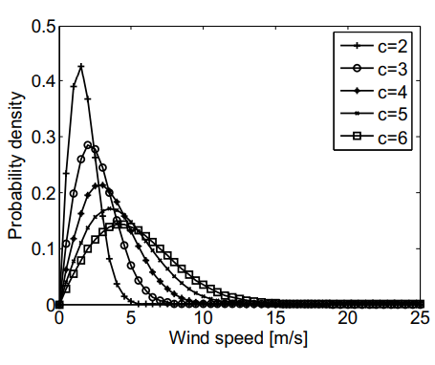
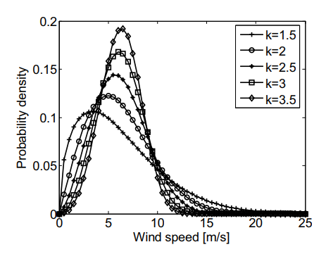

Wind Energy Resource
Most Probable Wind Speed $v^{∗}$ of the given site increases with the Weibull distribution Scale Factor c and Shape Factor k.
$$v^{∗} =c.{(1−\frac{1}{k})}^{\frac{1}{k}}$$

Slide 3
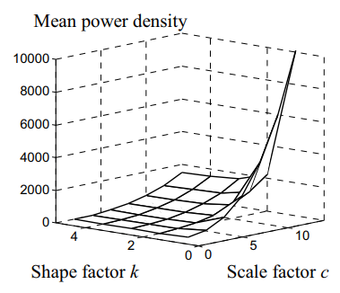
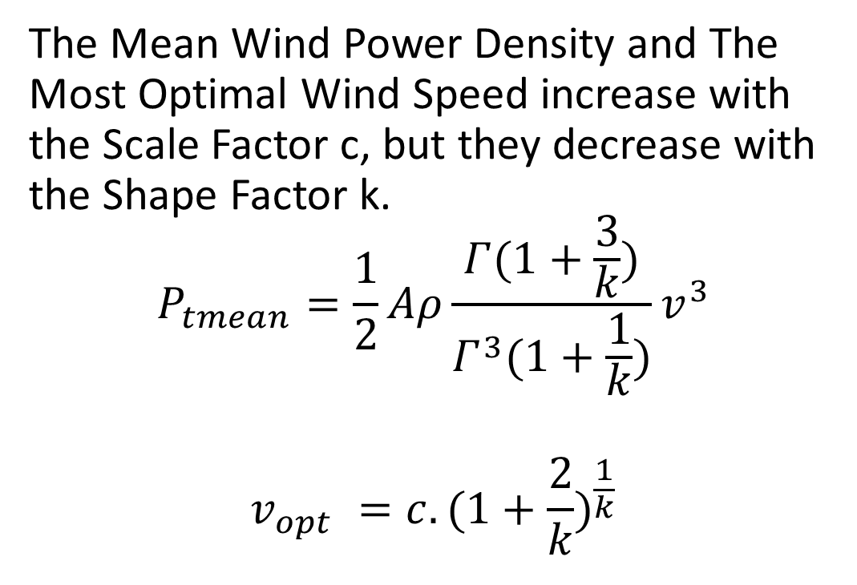
Wind Energy Resource
The Mean Wind Power Density and The Most Optimal Wind Speed increase with the Scale Factor c, but they decrease with the Shape Factor k.
$$P_{tmean}=\frac{1}{2}Aρ\frac{Γ(1+\frac{3}{k})}{Γ^{3}(1+\frac{1}{k})}v^{3}$$
$$v_{opt} =c.{(1+\frac{2}{k})}^{\frac{1}{k}}$$

Slide 4
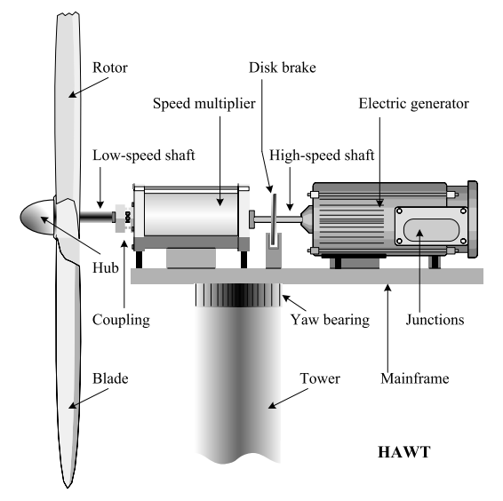
WECS Technology
Horizontal Axis Wind Turbine Energy Conversion Chain:
Aerodynamic Subsystem (Turbine Rotor and Turbine Hub)
Drive Train (Low-speed shaft, Speed Multiplier and High-speed shaft)
Electromagnetic Subsystem (Electric Generator)
Electric Subsystem (Elements for Grid Connection)

Slide 5
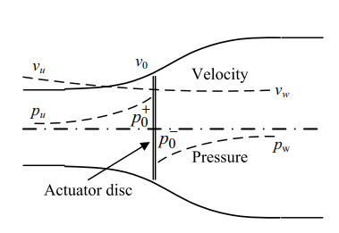
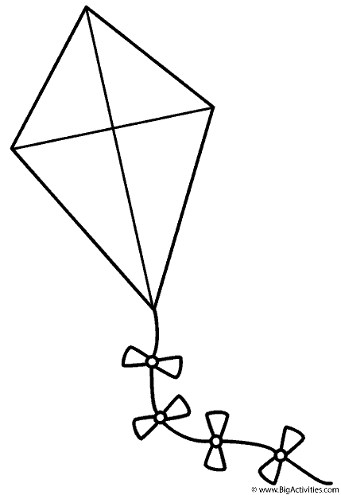
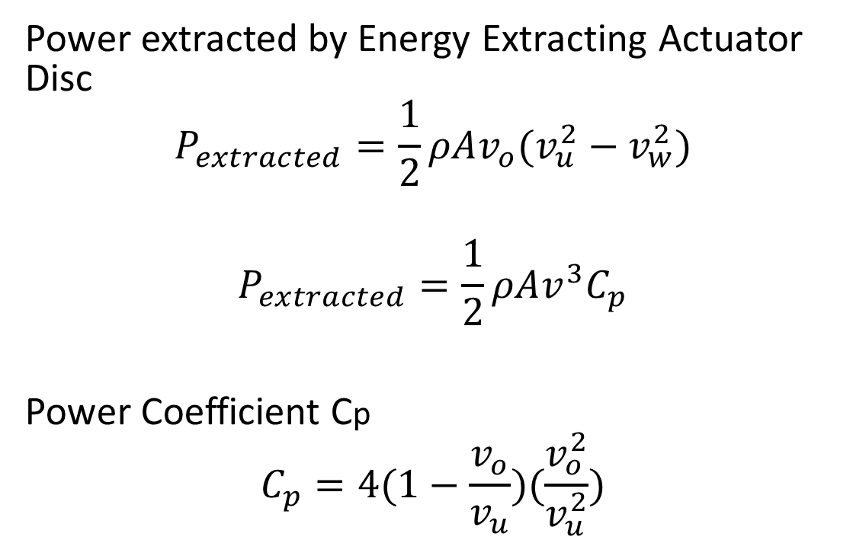
Wind Turbine Aerodynamics
Power extracted by Energy Extracting Actuator Disc
$$P_{extracted}=\frac{1}{2}ρAv_{o}(v_{u}^{2}−v_{w}^{2})$$
$$P_{extracted}=\frac{1}{2}ρAv^{3}C_{p}$$
Power Coefficient Cp
$$C_{p}=4(1−\frac{v_{o}}{v_{u}})(\frac{v_{o}^{2}}{v_{u}^{2}})$$

Slide 6
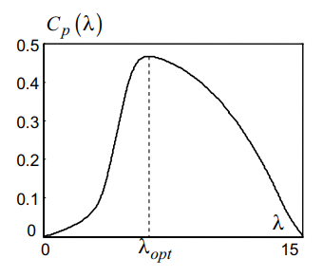
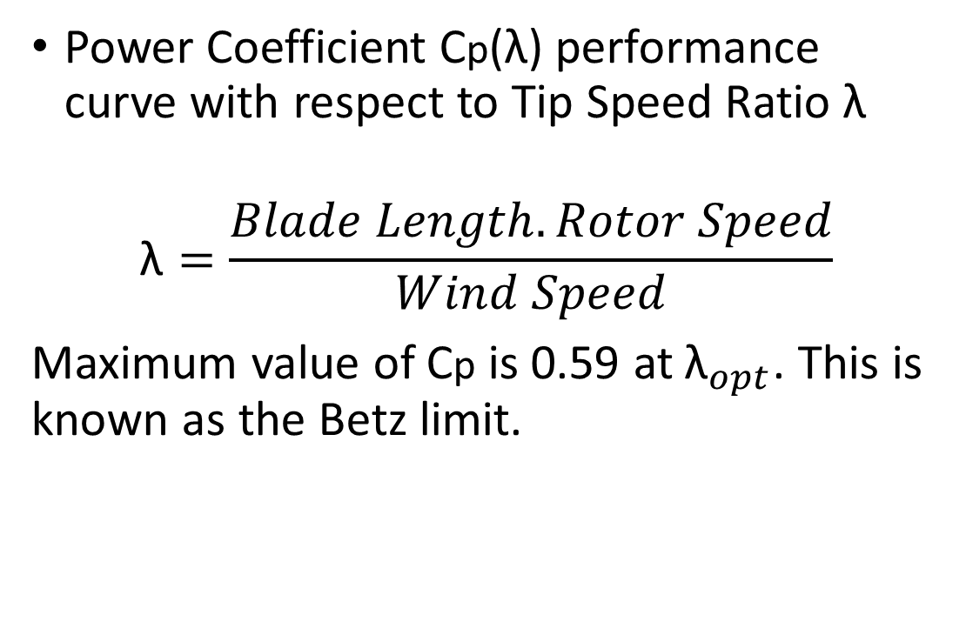
Wind Turbine Aerodynamics
Power Coefficient Cp(λ) performance curve with respect to Tip Speed Ratio λ
$$\text{λ}=\frac{Blade Length.Rotor Speed}{Wind Speed}$$
Maximum value of Cp is 0.59 at${ \text{λ}}_{opt}$. This is known as the Betz limit.

Slide 7
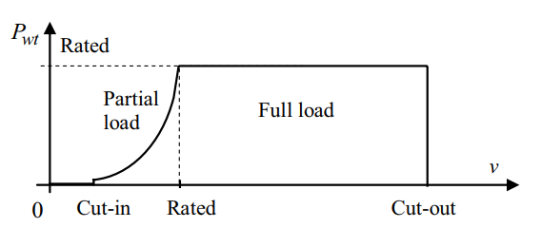
Wind Turbine Aerodynamics
Output Power vs. Wind Speed Characteristic

Slide 8
Drive Train

Slide 9
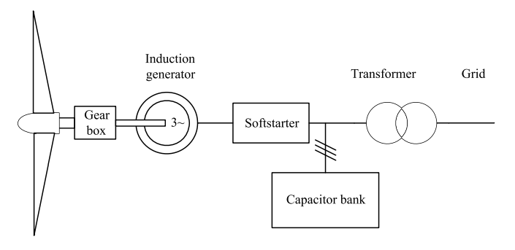
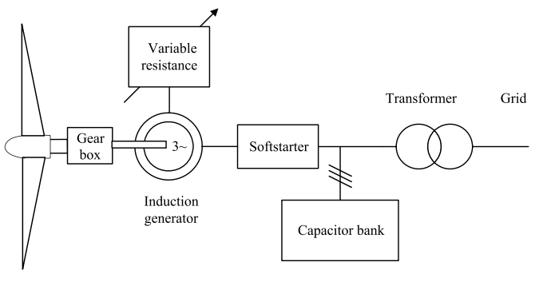
Power Generation System
Fixed-speed WECS:
General structure of a fixed-speed WECS
General structure of a limited variable-speed WECS

Slide 10
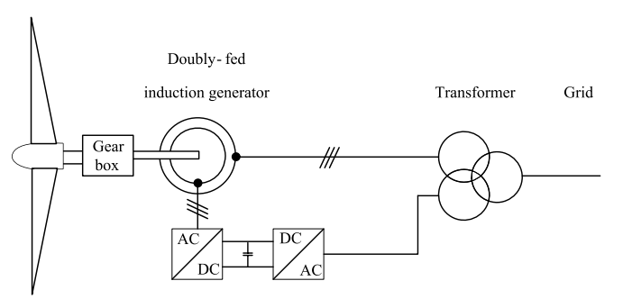
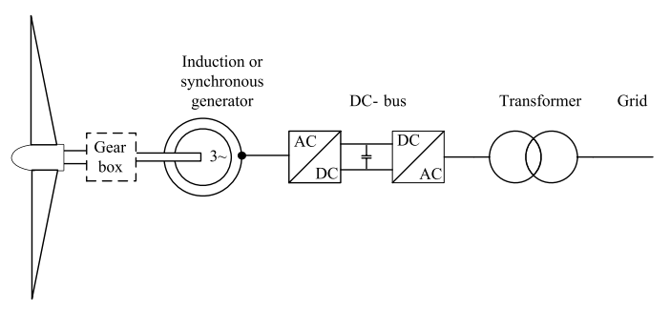
Power Generation System
Variable-speed WECS:
General structure of an improved variable-speed WECS
General structure of a full variable-speed WECS

Slide 11
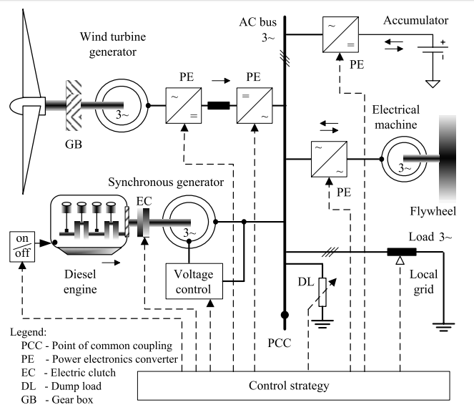
Wind Turbine Generators in Hybrid Power Systems
AC-coupled hybrid generation system:
Generators (Wind Turbine Generator, Diesel Power Plant)
AC Bus
Energy Storage (Accumulator, Flywheel)
Loads
Control System

Slide 12
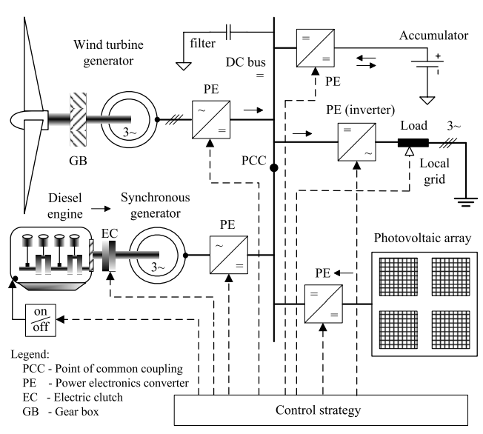
Wind Turbine Generators in Hybrid Power Systems
DC-coupled hybrid generation system:
Generators (Wind Turbine Generator, Diesel Power Plant, Photovoltaic Cells)
DC Bus
AC Filter
Energy Storage (Accumulator)
Loads
Control System

Slide 13
Control Objectives

